Slide 1
MDS 561 Session 4

Slide 2
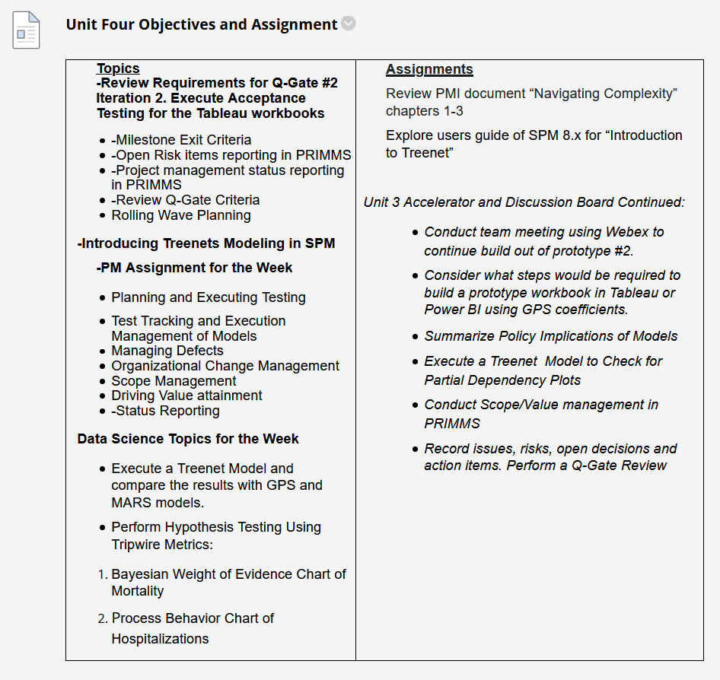
Week 4
We will just use Tableau but Power BI is Allowable
Megan brought this Tableau offer to our attention.
90 days of free eLearning

Slide 3
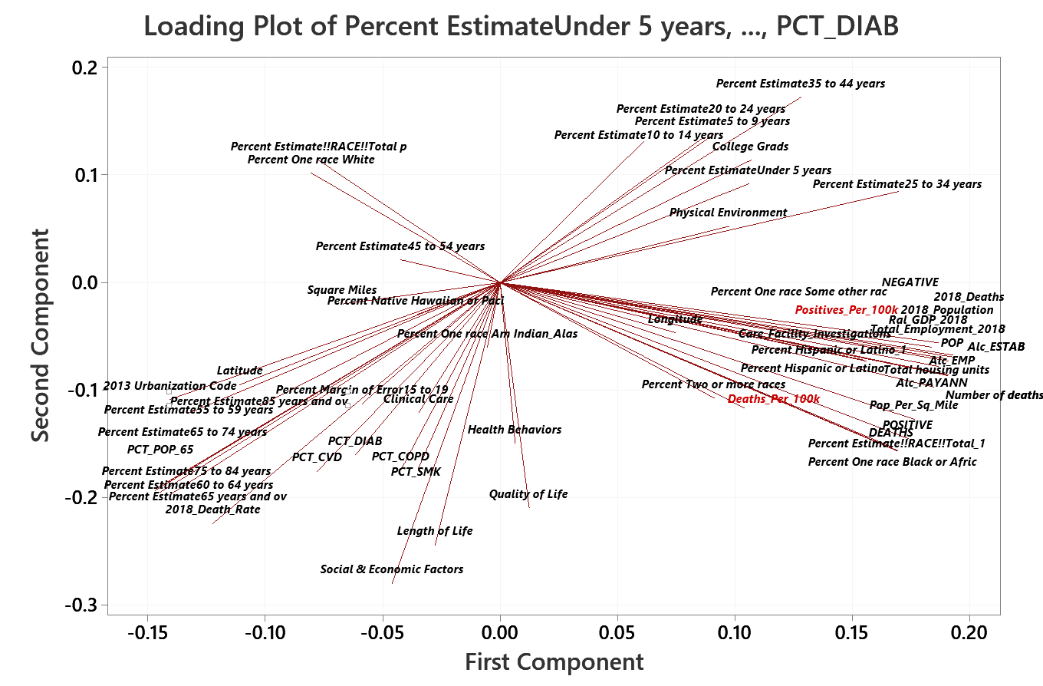

Slide 4
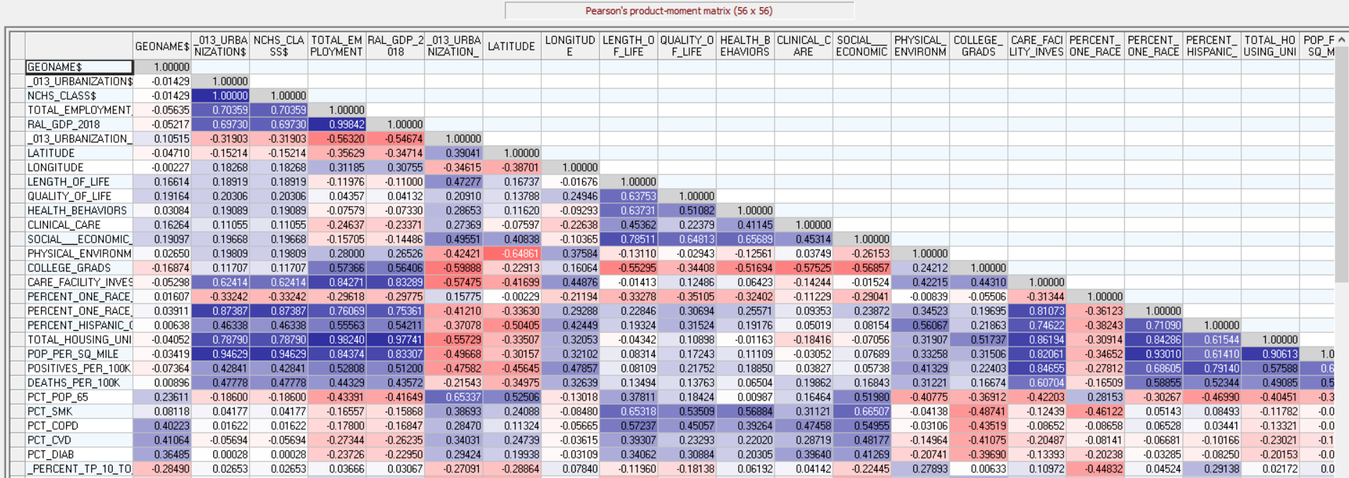
Reviewing the Correlation Matrix Is an Important Step

Slide 5
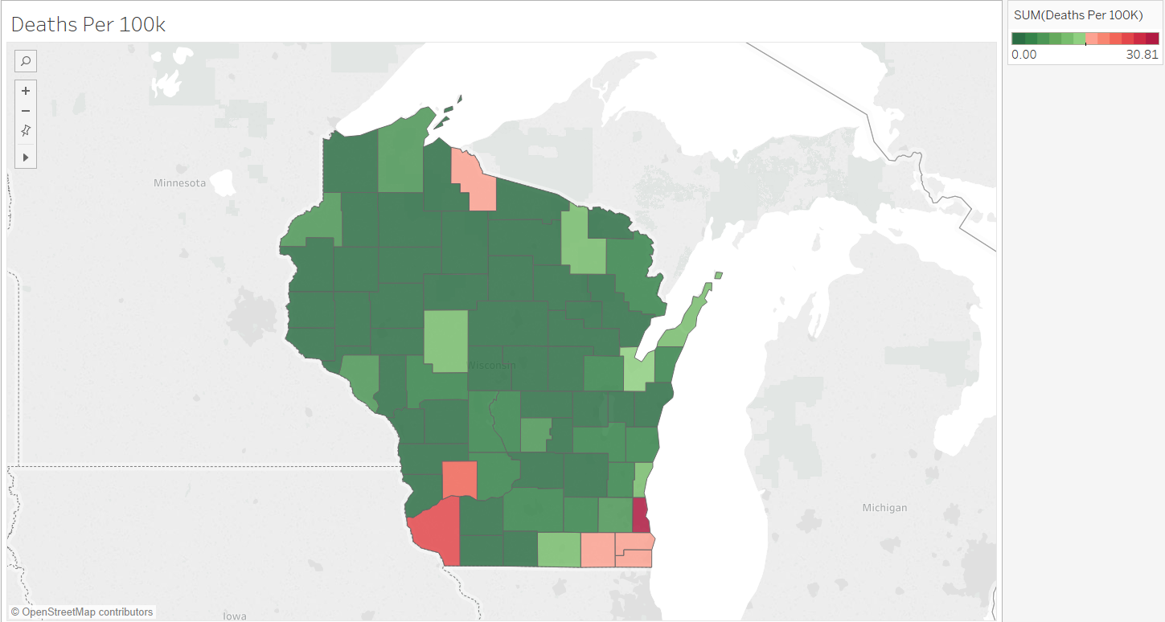
A Geographic Picture Helps Generate New Theories and Hypotheses.

Slide 6
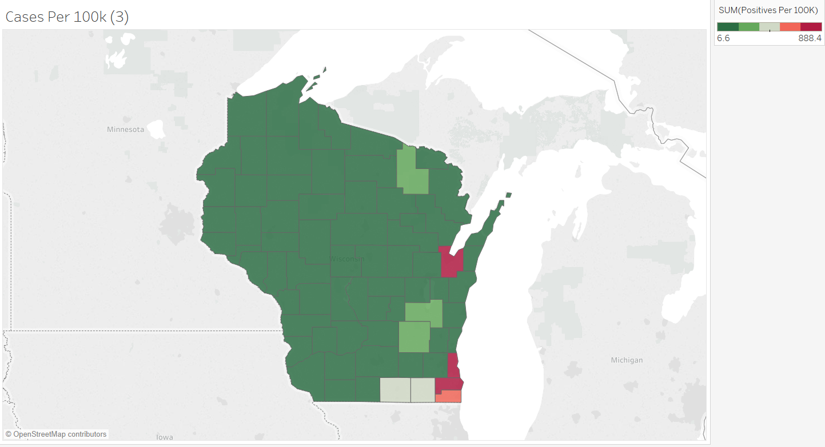

Slide 7
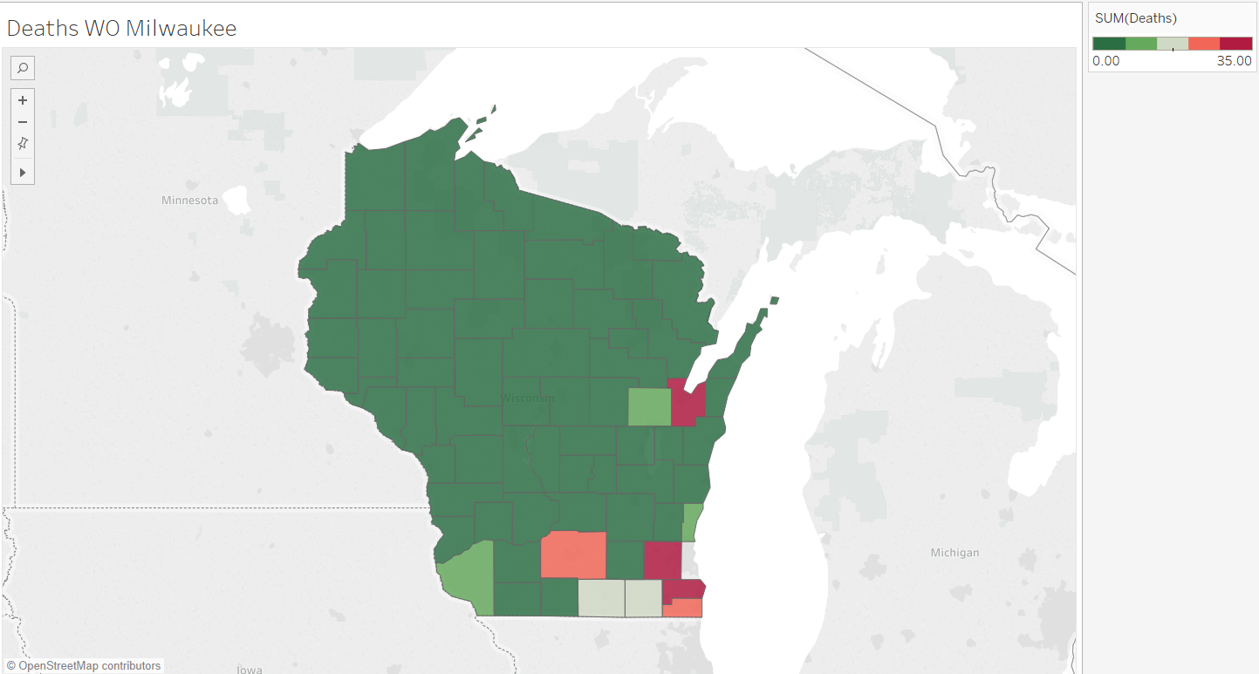

Slide 8
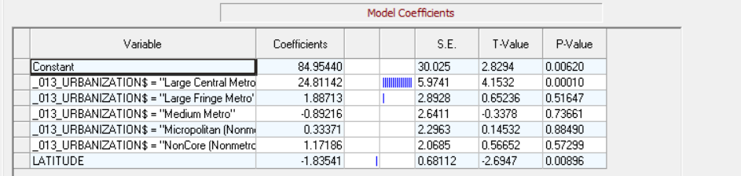

Slide 9
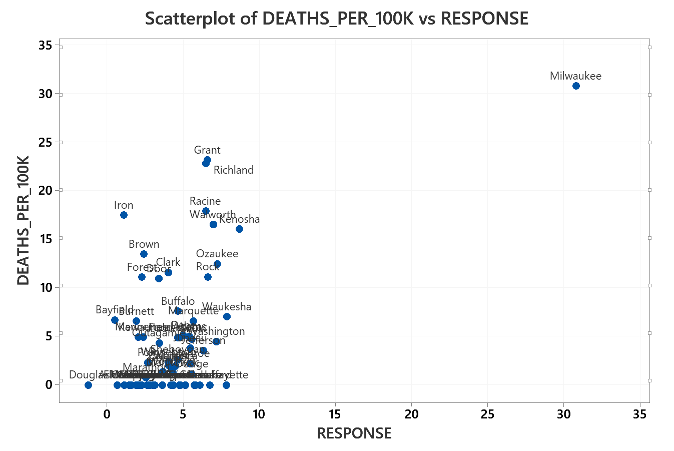

Slide 10
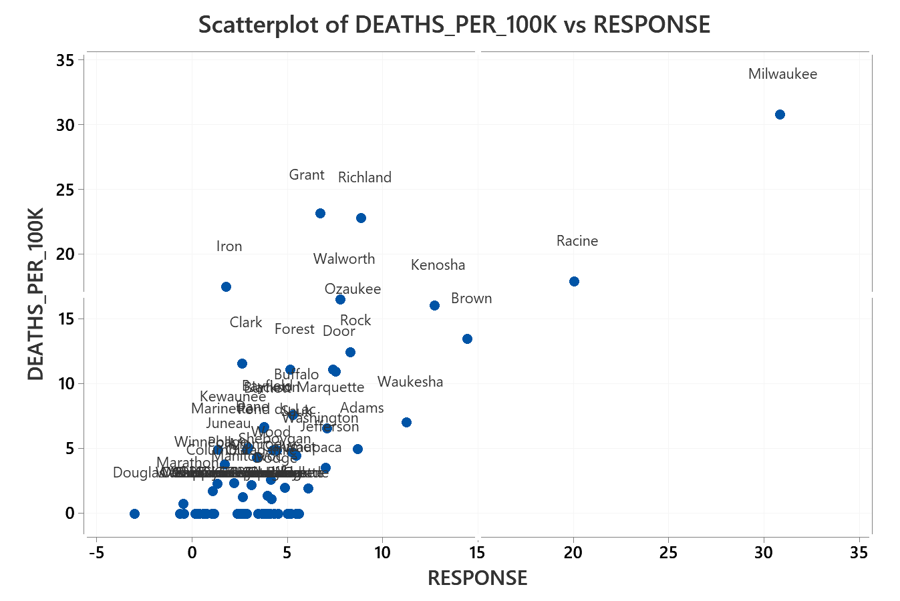
GPS

Slide 11
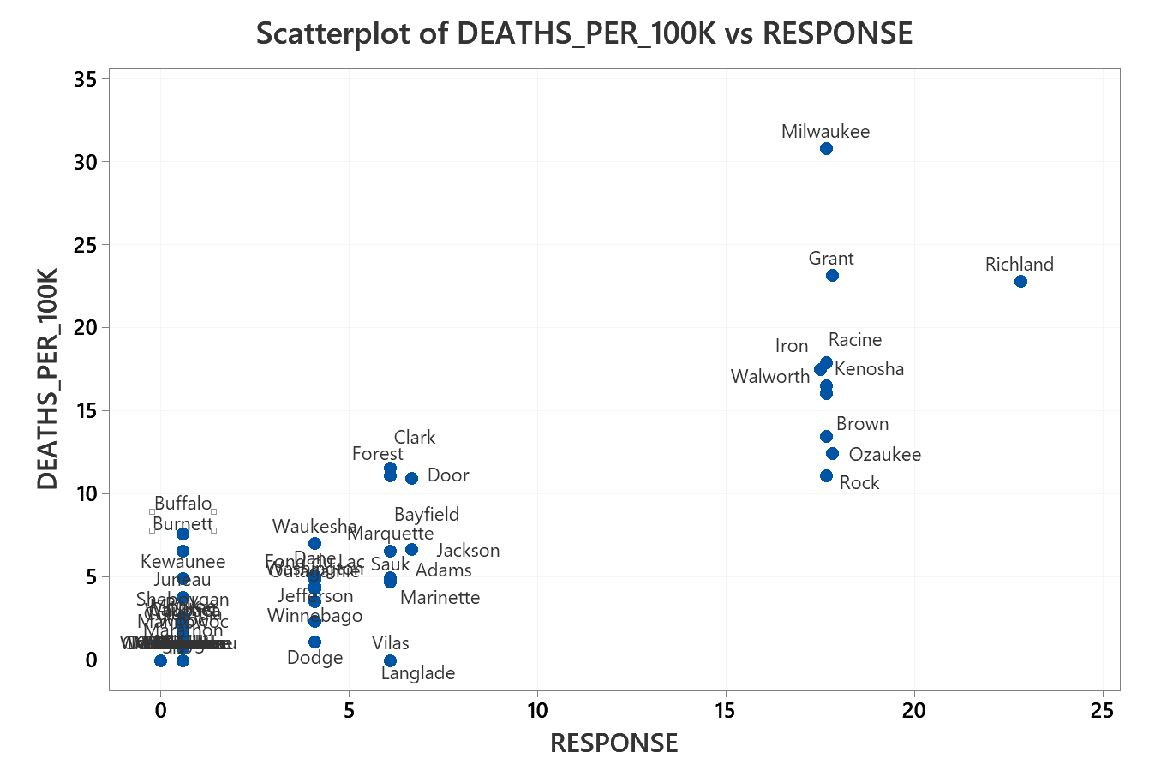
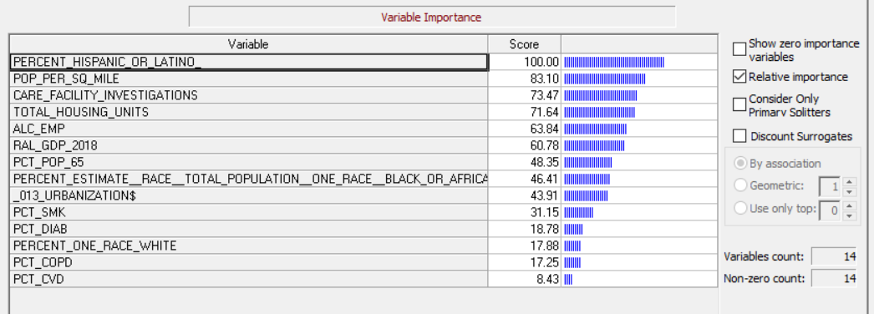
CART

Slide 12
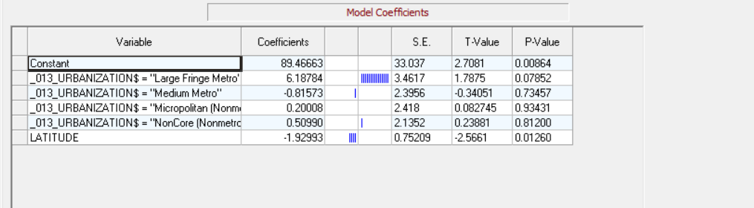

Slide 13
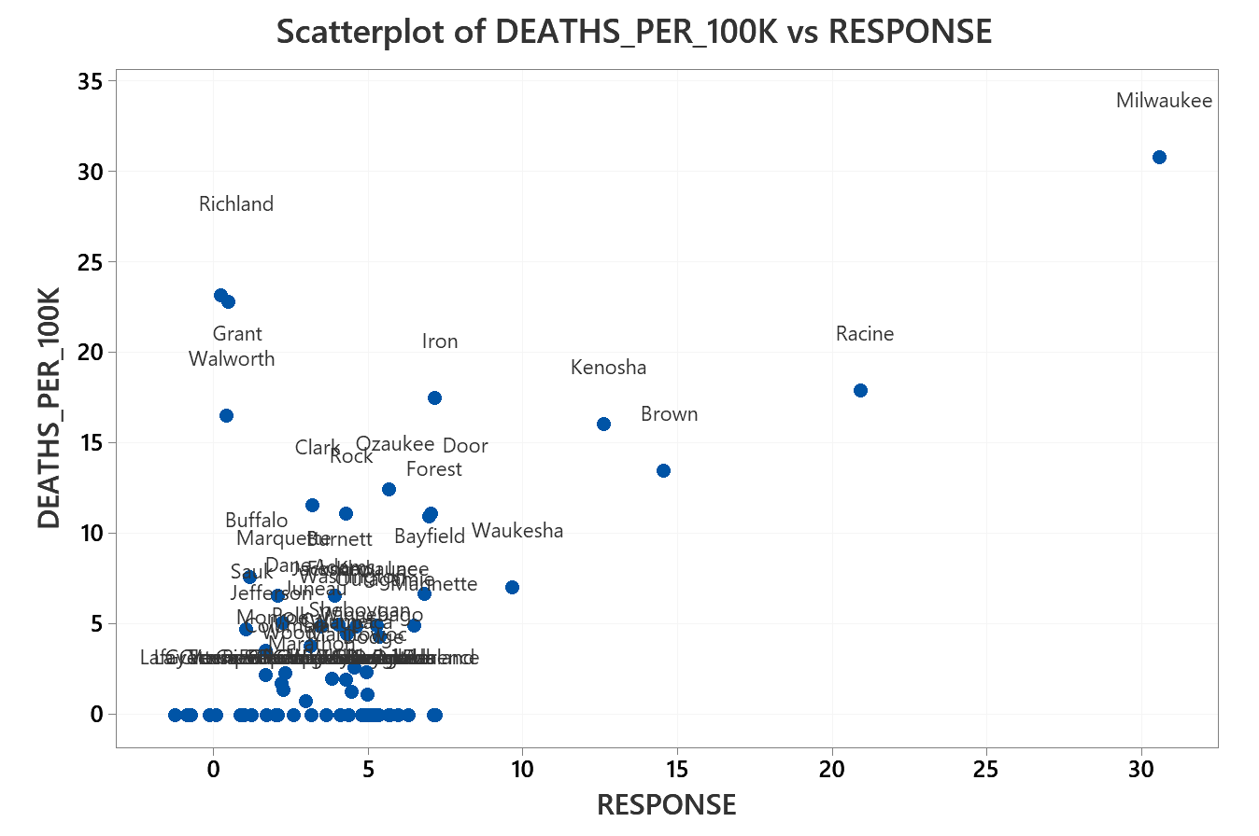

Slide 14
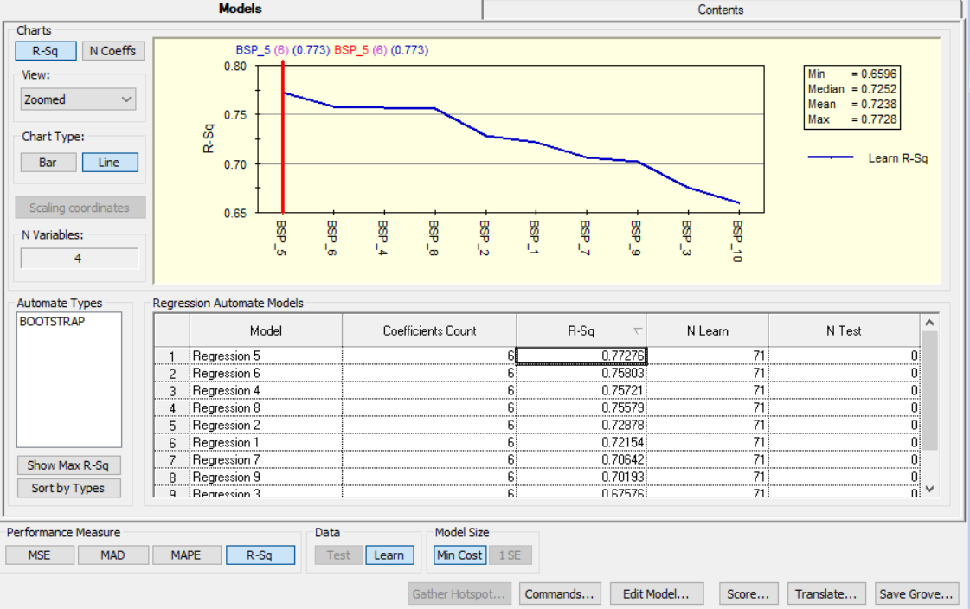

Slide 15
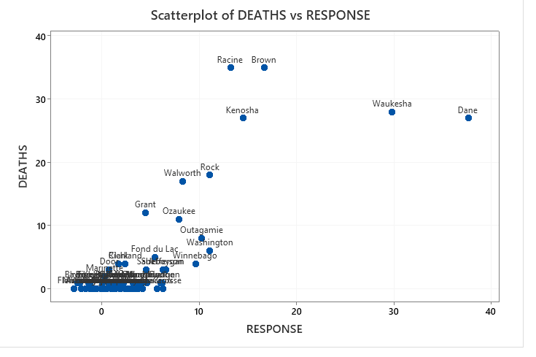
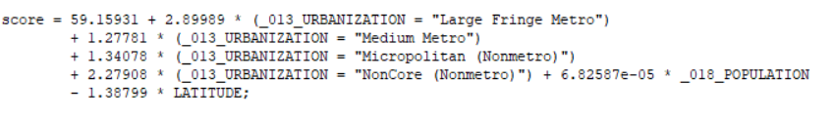
Milwaukee Removed

Slide 16
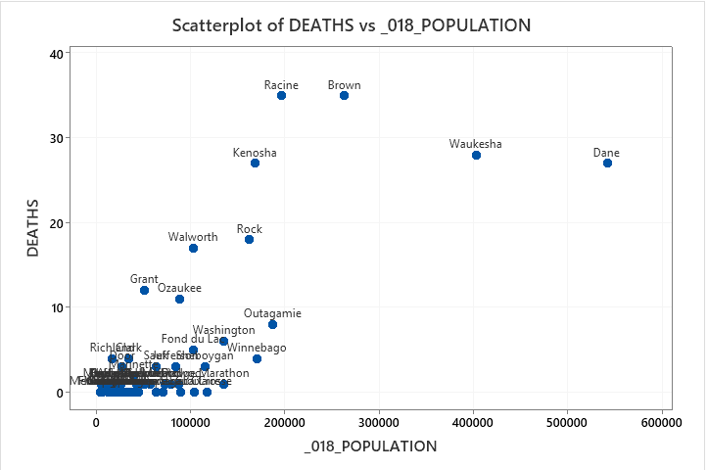

Slide 17
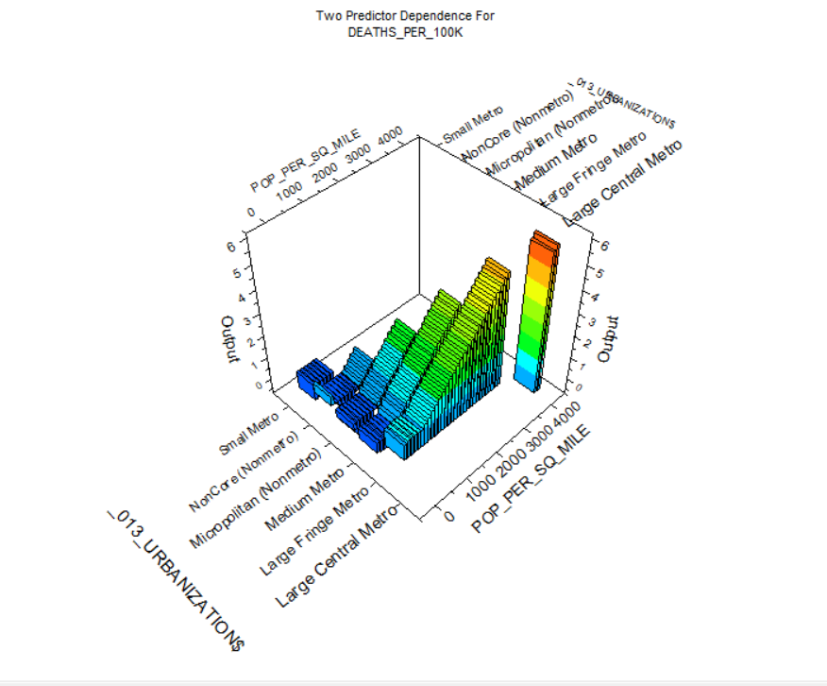

Slide 18
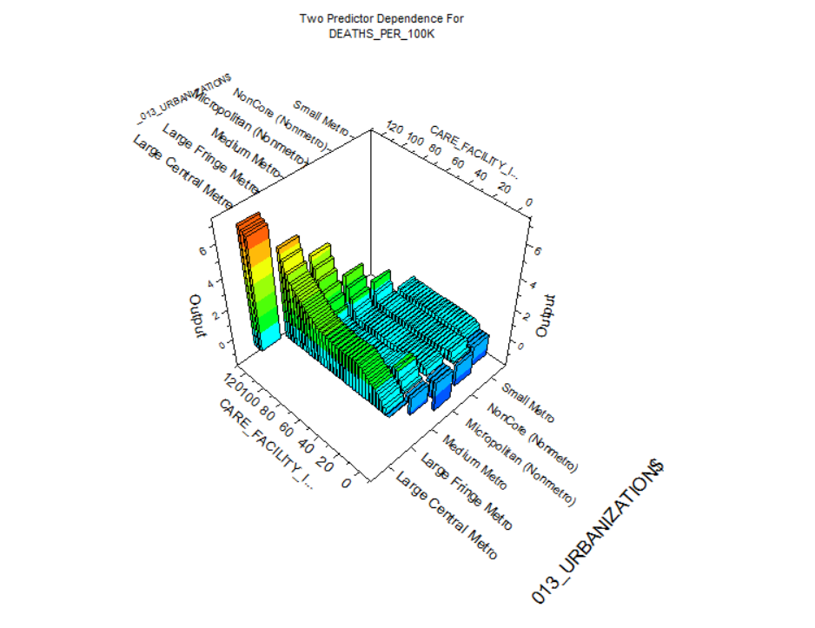

Slide 19
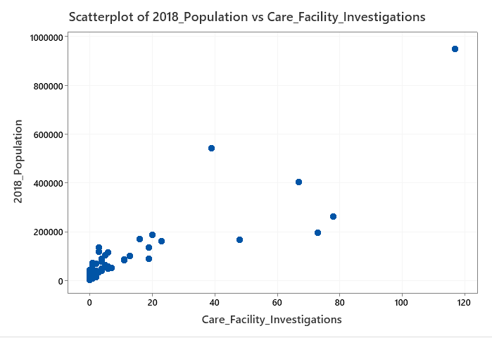

Slide 20
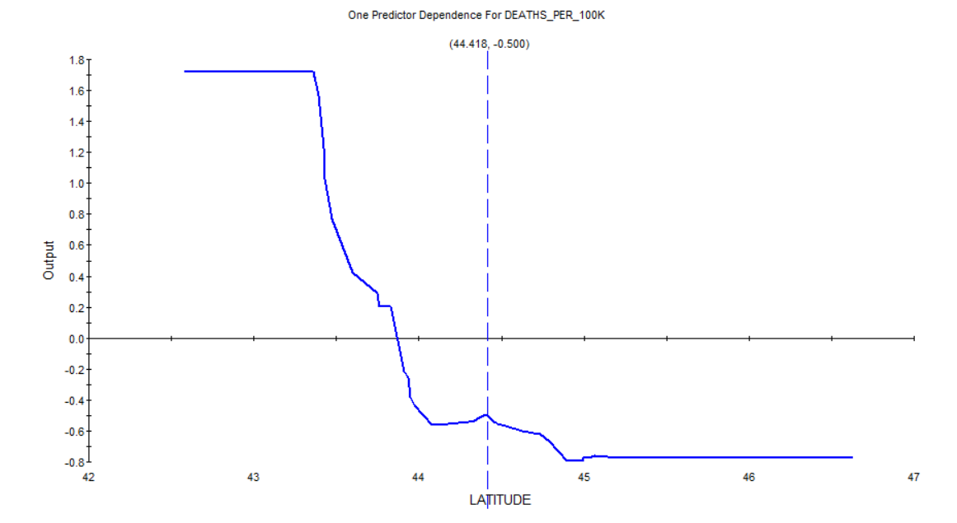

Slide 21
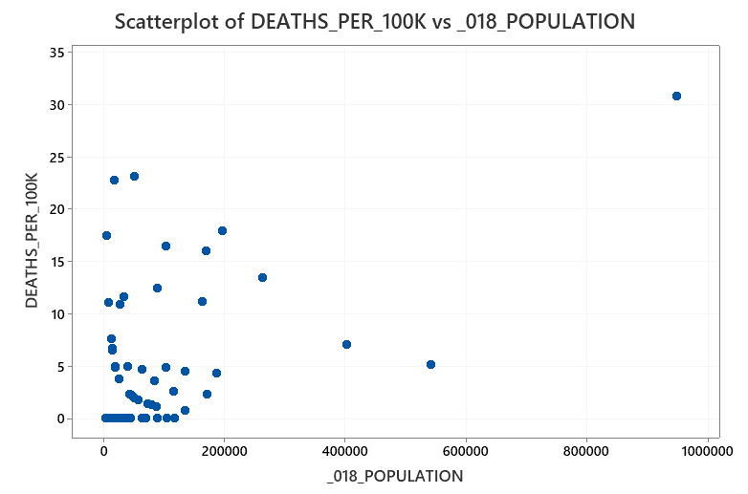
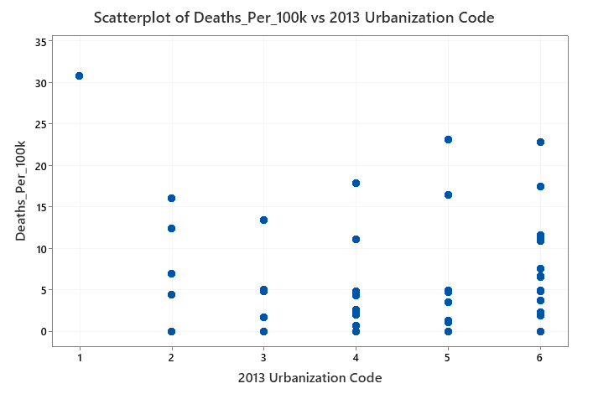
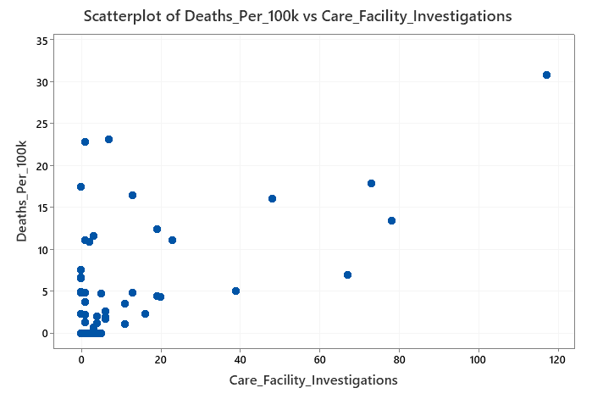

Slide 22
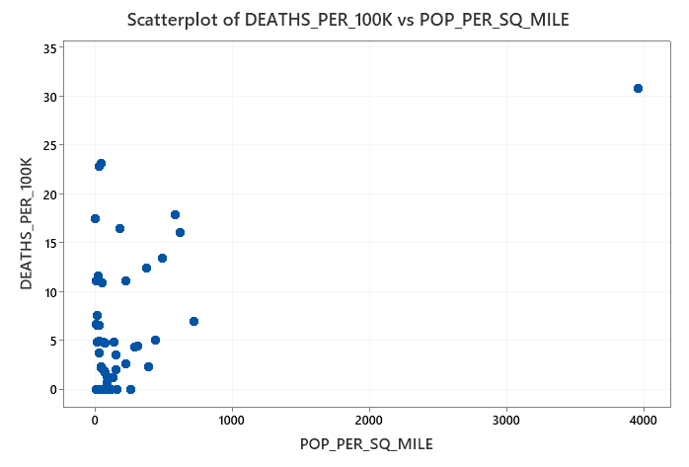
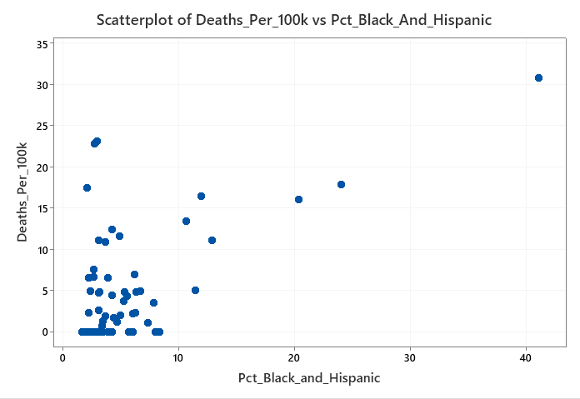
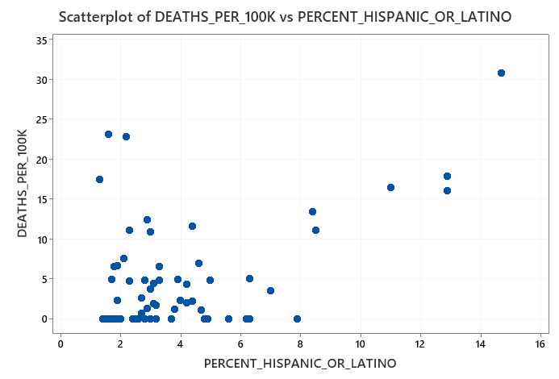
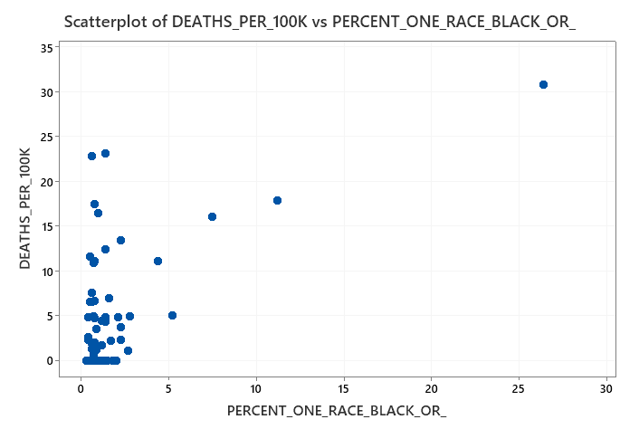

Slide 23
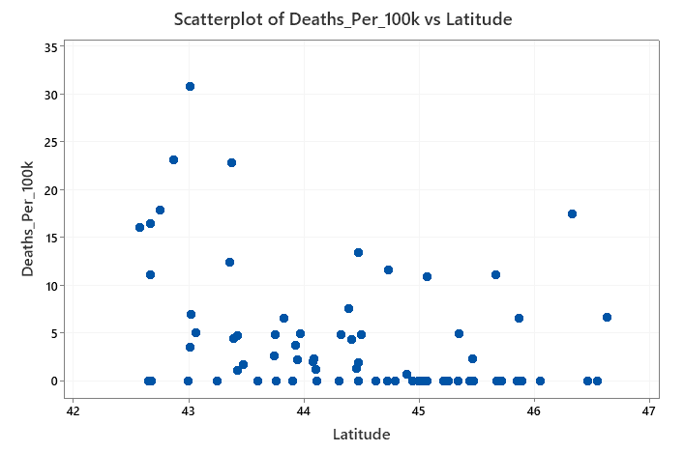

Slide 24
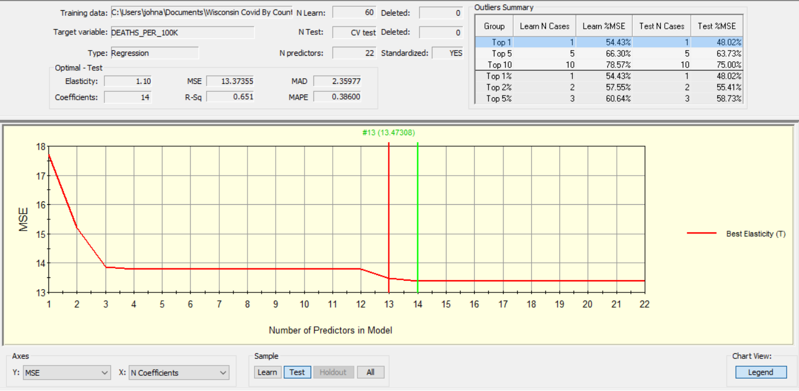

Slide 25
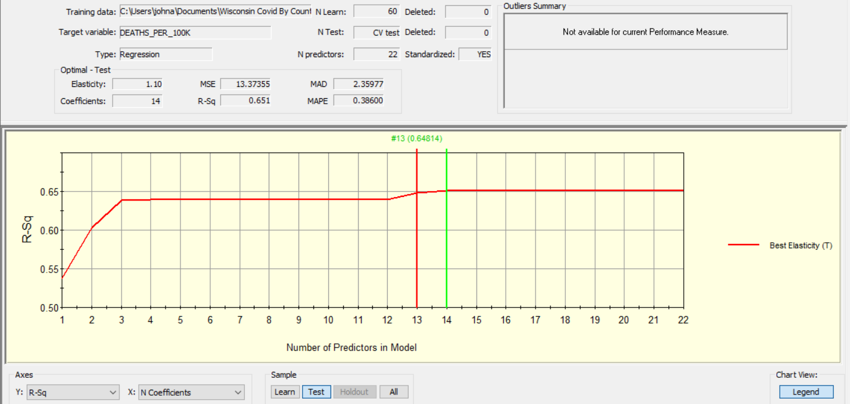

Slide 26
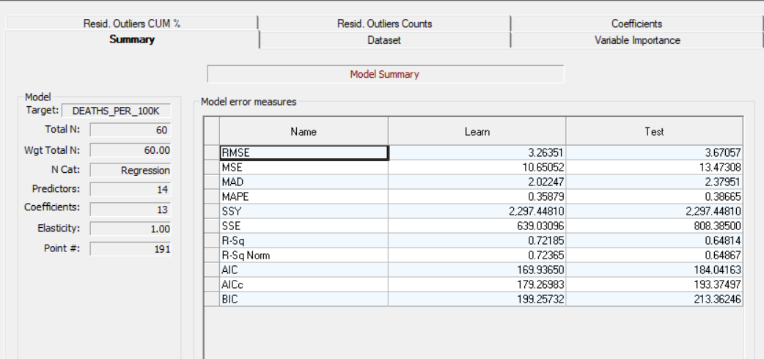

Slide 27
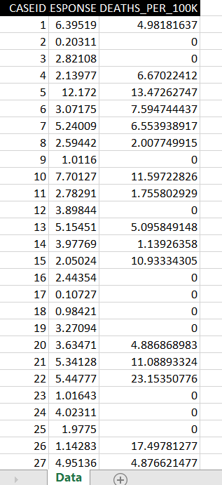

Slide 28
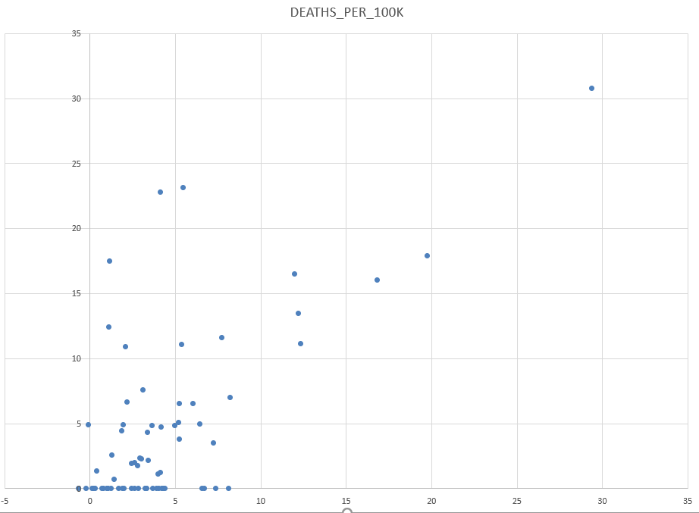

Slide 29
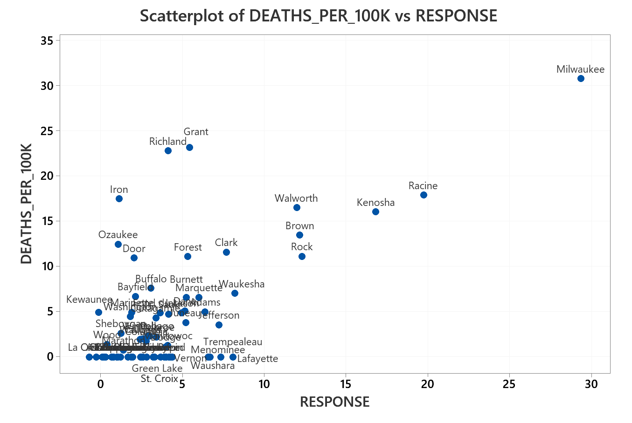
Outliers

Slide 30
Milwaukee Removed

Slide 31
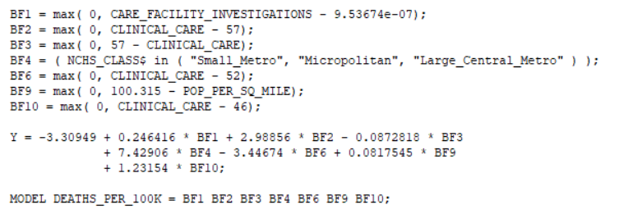
GPS Model

Slide 32
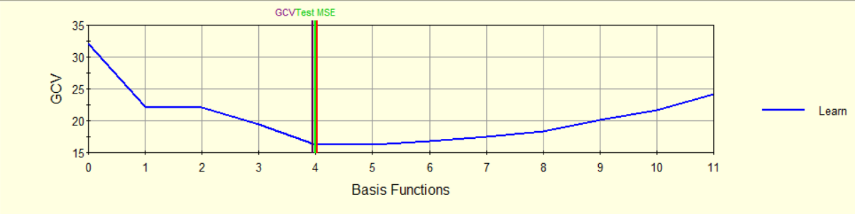
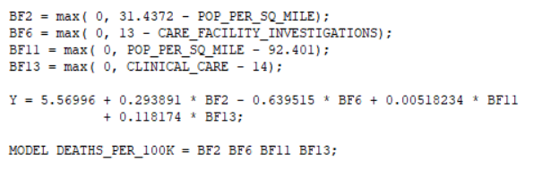

Slide 33
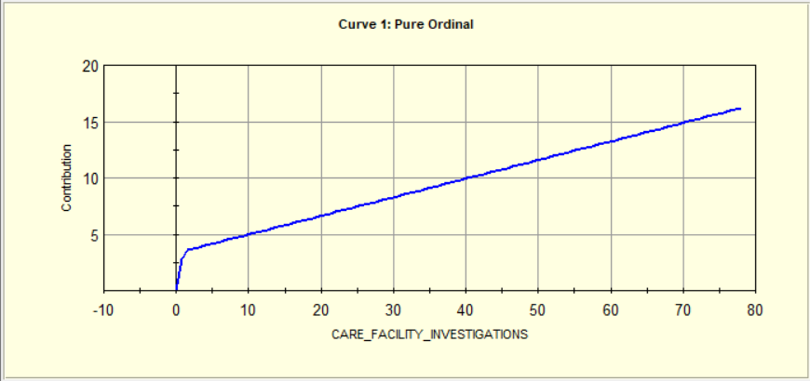
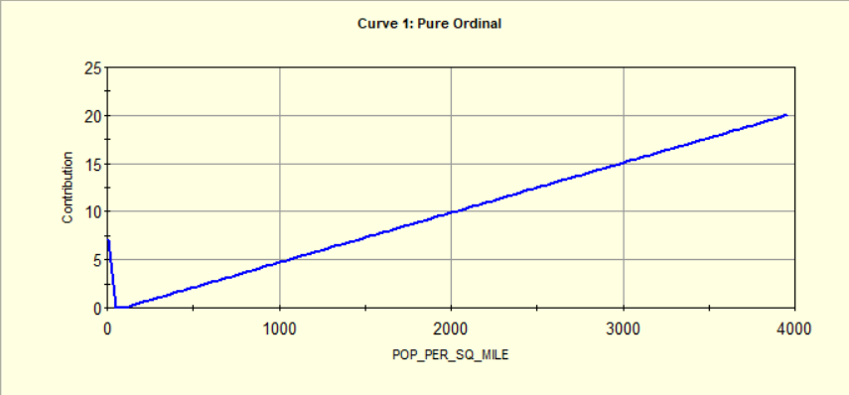

Slide 34
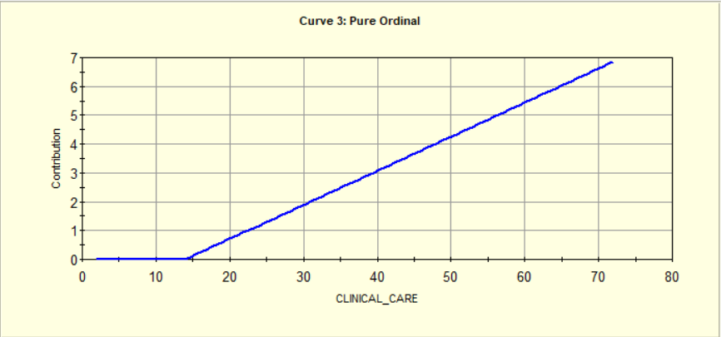

Slide 35
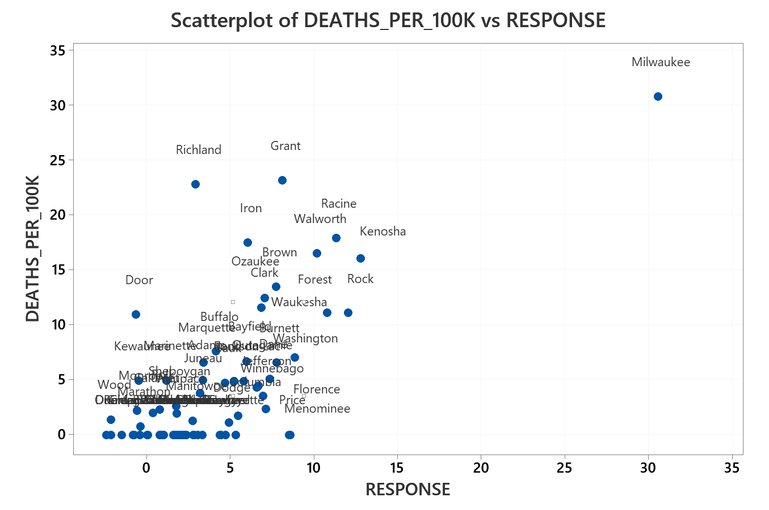

Slide 36
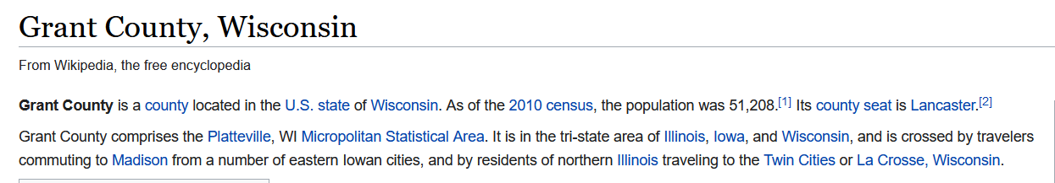

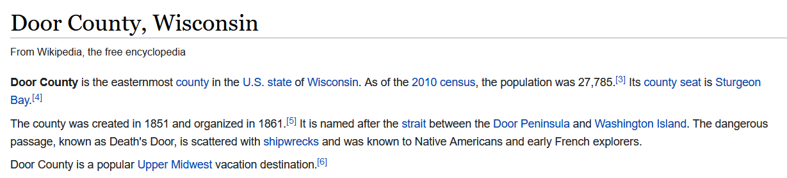
Travel from Contiguous States and Large Cities????
Travel from Illinois?
Low populations in county

Slide 37
Progress on Week 3 Accelerator Assignment With IBM Attrition Dataset

Slide 38
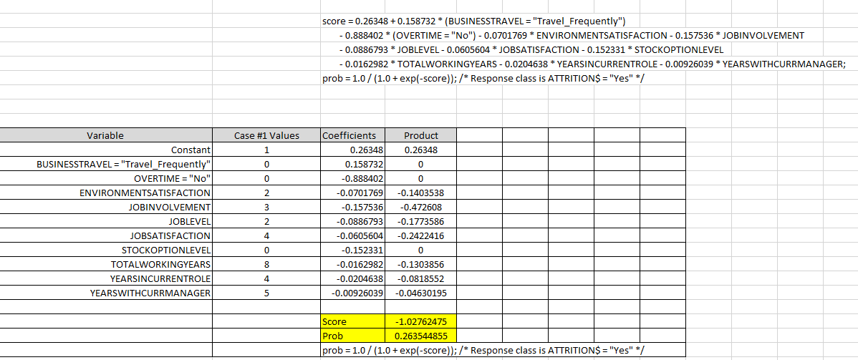
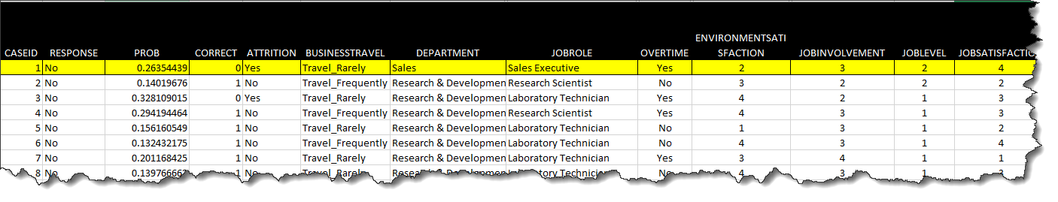
If categorical variables are true, then values go to 1.
Validating GPS Scoring of Attrition Dataset
Threshold is 0.5, so response is “No”

Slide 39
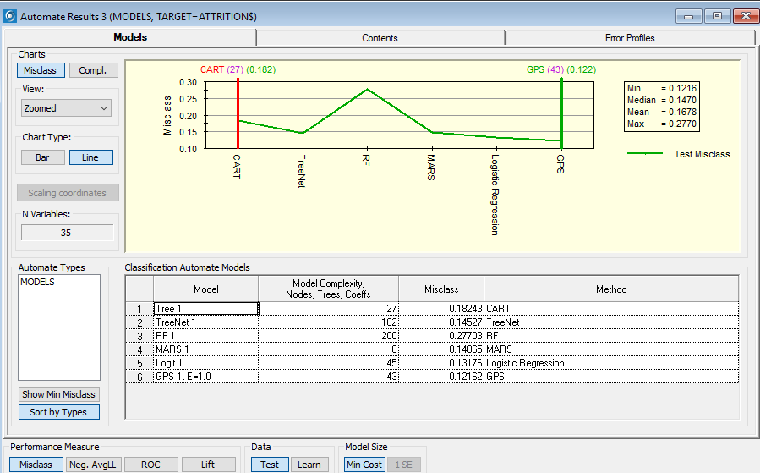
By Using the Automate Function We Can Compare Performance Across Modeling Engines
Misclassification as Criterion

Slide 40
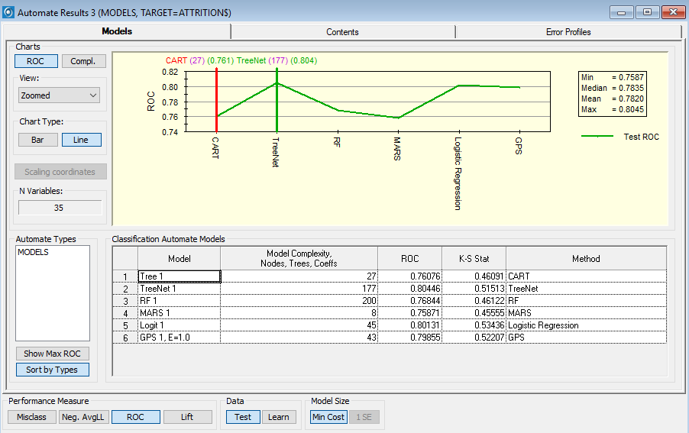
By Using the Automate Function We Can Compare Performance Across Modeling Engines
ROC as Criterion

Slide 41
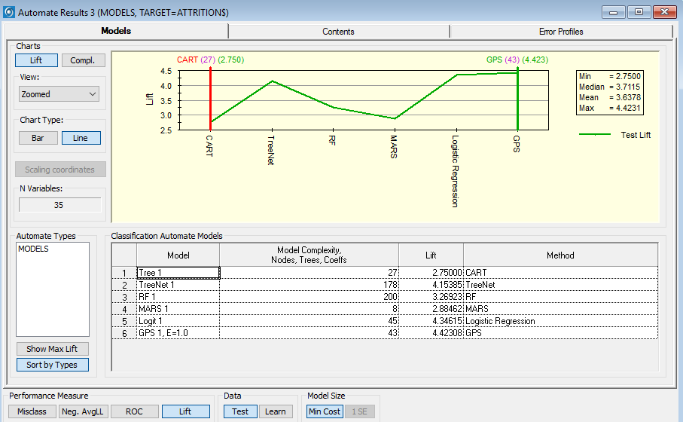
Lift as Criterion

Slide 42
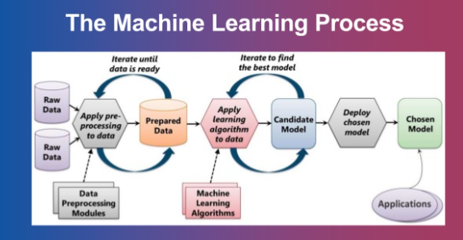
Internal Users
(e.g. Tableau Workbooks)
External Customers Users
(e.g. Web Service)

Slide 43
A Walkthrough of What We Have Achieved Thus Far

Slide 44

The PM Strategy: A Revised CRISP-DM Project Methodology with Three Deliverables
Quality Gate Reviews
Project Charter, Value Map and Requirements
Baseline Project Schedule
Business Sign-off and Project Authorization. Scope Change Control
Data Ready
First Models Completed
Issues and Gaps Documented
Causal Factors Identified
Process Improvements Made
Deployment Model Refined
Data Readiness
Scoring Deployed
User Training Delivered
Issues and Defects Captured and Closed
Phase Exit Review Completed
Future State Process Documented for Resume’ Screening
Resume’ Automation Built, Tested and Deployed
User Training Delivered
Issues and Defects Closed
Support and Maintenance Begins

Slide 45


Once the ML Model is Progressively Proven In Value, It is Deployed With Increasing Investment
Cycles Follow the Scientific Method
Deploy Scoring to Group With Access to Power BI/Tableau, etc.
Deploy Scoring for Enterprise
Usage and Interfaces
First Iteration
Second Iteration
Third Iteration
Explainable Knowledge
Of Business Process
Predictive Knowledge
Individual Business User
Predictive Knowledge
Enterprise Level

Slide 46


Begin With The Identification of Relevant Data Sources………….
Files…..
Servers…..

Slide 47

Our Sample Data Set: IBM Attrition Dataset—Each Record is an Employee
n=1470

Slide 48


Suggests Diminishing Marginal Benefit
Accuracy Measure For Test Dataset
GPS Runs Many, Many Models. Variable Importance Using All the Data Gives Us a New Perspective …Possible Surprises

Slide 49


ROC, Lift and Gain Measures From Test Dataset

Slide 50


Balance
An extensive model, are all of these variables needed?
Some might be expensive to acquire and maintain.

Slide 51


Sales
Entry Level
Predictor Dependence Plots From Treenets Fill In Major Pieces of the Puzzle

Slide 52



Slide 53

We Can Also Use Variable Importance Averaging Across Various Modeling Types and Complexities

Slide 54


Less Complexity Option Can Help Mitigate Data Readiness Risks and Simplify Deployment
Fewer Data Objects Needed
If you wish to remove sensitive variables such “age” from the model, go back and uncheck age and then rerun the model.

Slide 55


With The Variable “AGE” Removed

Slide 56

Scoring the Model Becomes Key for Predictions
We Score the Model

Slide 57

X Variables with or without labels
Saving the output
Starts Scoring

Slide 58


Output File from the Scoring Enables Us to Validate Scoring For Deployment of Linear Models
Output from Translate
For Instance, We Might Validate Case Number 1,
how does it compute the probability of 0.26354439?
How does it compute the response “No”

Slide 59
Validating GPS Scoring of Attrition Data Set

Slide 60
Options for Deploying the Predictive Scoring For Group Use
Excel Workbooks Using VBA Macros
Visualization Tools Such As Power BI and Tableau With Group Access
Server
Cloud

Slide 61

By Using the Automate Function We Can Compare Predictive Performance Across Modeling Engines---Linear Models Perform Well Making Us Feel Confident We Can Deploy to Group
Misclassification as Criterion

Slide 62

By Using the Automate Function We Can Compare Performance Across Modeling Engines
ROC as Criterion

Slide 63

By Using the Automate Function We Can Compare Performance Across Modeling Engines
Lift as Criterion

Slide 64




Tableau Or Power BI Option For Deployment If We Use Linear Predictive Models
Any Dataset Can Be Brought In
Examples: Weight Calculations

Slide 65

Example: Augmenting Predictions With Other Visualizations/Analytics
Which Can Be Performed By Managers To Classify Their Own Employees at Their Own Facilities

Slide 66
Let’s Go Into Tableau and Examine the Workbook
Import the file to be scored
Create the calculated fields
Validate the calculations
Deploy for user access
Provide documentation/training
Users score their own unlabeled data and take preventative and corrective actions
Modeler maintains the model

Slide 67
As Demand Justifies, We Then Then Migrate the Model to the Enterprise Level
Cycles Follow the Scientific Method
Deploy to Server or Cloud (could be Tableau or Power BI)
Deploy Excel Workbooks to Users
First Model
Followed By Iterations
Second Iteration
Third Iteration
Explainable Knowledge
Of Business Process
Predictive Knowledge
Individual Business User
Predictive Knowledge
Enterprise Level

Slide 68

Drive Specificity

Slide 69

Organizational Change Management
“Change Management is a comprehensive, cyclic and structured approach for transitioning individuals, groups and organizations from a current state to a future state with intended business benefits.”
PMI: Managing Change in Organizations-A Practice Guide

Slide 70


Slide 71


Slide 72



Slide 73


Slide 74


Slide 75

Strong Interaction Reporting

Slide 76


Slide 77


Slide 78


Slide 79


Slide 80

Complexity Can Be Reduced

Slide 81

But programming of trees is likely beyond the skillset of the average business user.
However, tools like Excel VBA, Tableau and Power BI Can Be a Good Compromise.

Slide 82
Deployment of Treenet
Trees Can Be Very Complex Code—Will Require IT Help Which Increases Project Management Complexity and Project Cost/Risk
Suggest comparing advantages in scoring accuracy over a linear model versus costs. May be better to keep Treenets at the desktop, but deploy linear models.
Purchasing and deploying multiple copies of the SPM application might be the most cost effective alternative if cost justified. Or use alternative engines and architectures if they can produce the benefit.

Slide 83
Tripwire Metrics and Hypothesis Testing

Slide 84

We Have Been Presented With Compelling Evidence As To Why An Emergency Situation Was Declared For Certain Geographical Regions
Example: New Jersey

Slide 85


But The Problem Does Not Effect All Geographical Regions Equally
Some States Caught Up In the Principle of Insufficient Reason and Treated All Regions Uniformly—not an optimal policy
https://nj.gov/health/chs/documents/2015-2020%20Deaths%20by%20Month%20and%20County%20of%20Residence.pdf

Slide 86
Need for Hypothesis Testing and Tripwire Metrics at the Local Level
Devastating Impact from Virus and Economic Decline
Strategy Requires Us to Prevent Future Disruption https://info.minitab.com/resources/videos/webinars-on-demand/elmhurst-college-reopening
Plus Some Concern About Policy Guidance From CDC:
Swiss Research Report https://swprs.org/a-swiss-doctor-on-covid-19/
Ferguson and Imperial College Model
https://www.nationalreview.com/corner/professor-lockdown-modeler-resigns-in-disgrace/
https://www.armstrongeconomics.com/world-news/corruption/i-have-reviewed-fergusons-code/
Where is science in all of this?
Go Back to Basics
Peirce
Popper

Slide 87

Nantucket Massachusetts Example
Another source shows 1 COVID death
Must also consider availability of only 11 hospital beds

Slide 88

Method of Bayes Factors
Scenario If An Actual Crisis

Slide 89

Evidence
Evidence
Likelihood Ratio:
0.025/0.160=0.156
10Log₁₀ Odds= -8.00
_{db= -8.00}
No Crisis Hypothesis
P(E|H₀)
Crisis Hypothesis
P(E|H₁)
https://1drv.ms/u/s!AsKbGD6G_CsKojwPruKR-TBrRlwz?e=4HeNF6

Slide 90


Slide 91


Plausibility

Slide 92

Scenario of What is Likely Happening

Slide 93


Slide 94


Threshold Selection from E.T. Jaynes

Slide 95

Normal Distribution

Slide 96


Slide 97


Only

Slide 98

The Factor

Slide 99


Slide 100


Slide 101
Weighing of Evidence and Bayes Theorem: Hypothesis Testing With Minimal Samples
https://1drv.ms/u/s!AsKbGD6G_CsKojwPruKR-TBrRlwz?e=lGUI0M

Slide 102


Slide 103


Slide 104


Slide 105


Enigma
Tunny

Slide 106


Slide 107



Slide 108





The Challenge: How to Break the Ciphers Within 24 Hour Cycles
Alan Turing
Gordon Welchman
The “Enigma” Machine
And many other men and women….
Tommy Flowers
I.J. Good

Slide 109

First Part Interview with I.J. Good
https://www.youtube.com/watch?v=6p3mhkNgRXs

Slide 110

The Same Bayes’ Theorem We Used for Naïve Bayes Helped Them Break the Codes
And This Weight of Evidence Approach Will Be Used To Trigger City Response Plans
Likelihood
Add Log Likelihood Ratios
H=True
Count of interest
H=False
Count of interest
Transmission 1
Transmission 2

Slide 111



Slide 112


Slide 113


Slide 114

Example Adapted by ET Jaynes 1958

Slide 115

Your Instructor Put These Ideas To Work in PRIMMS

Slide 116

From: Jennifer Atlas at Minitab

Slide 117

From: Jennifer Atlas at Minitab

Slide 118

Hospitalizations

Slide 119


Slide 120


Slide 121



Slide 122


